Slide 1
Orphanage
Information System

Slide 2
team members
Rehab waleed saad رحاب وليد سعد
Zeinab Ahmed Muhammedزينب احمد محمد
Zeinab hamada seyedزينب حماده سيد
Doaa Ali Thabetدعاء علي ثابت
Rahma Bahaa Eldinرحمة بهاء الدين
Dimiana Fayek Shafikدميانة فايق شفيق

Slide 3
Project idea
The orphanage is an institution whose primary objective is to take care of children and provide them with various services such as education, food and care. Most of the activities carried out by the orphanage are based on external financial support, whether from the state or from the parents, and it offers the possibility of adoption to parents who are able and qualified to take care of children

Slide 4
Project idea
In this project, we will review the members of the orphanage and the relationship between them, and we will make inquiries about the members of the orphanage, as well as make reports so that the project appears to the reader and the user more clearly

Slide 5
Orphanage members
1-kids
2-Adoptive family
3- employees
4- Teachers
5-Manager

Slide 6
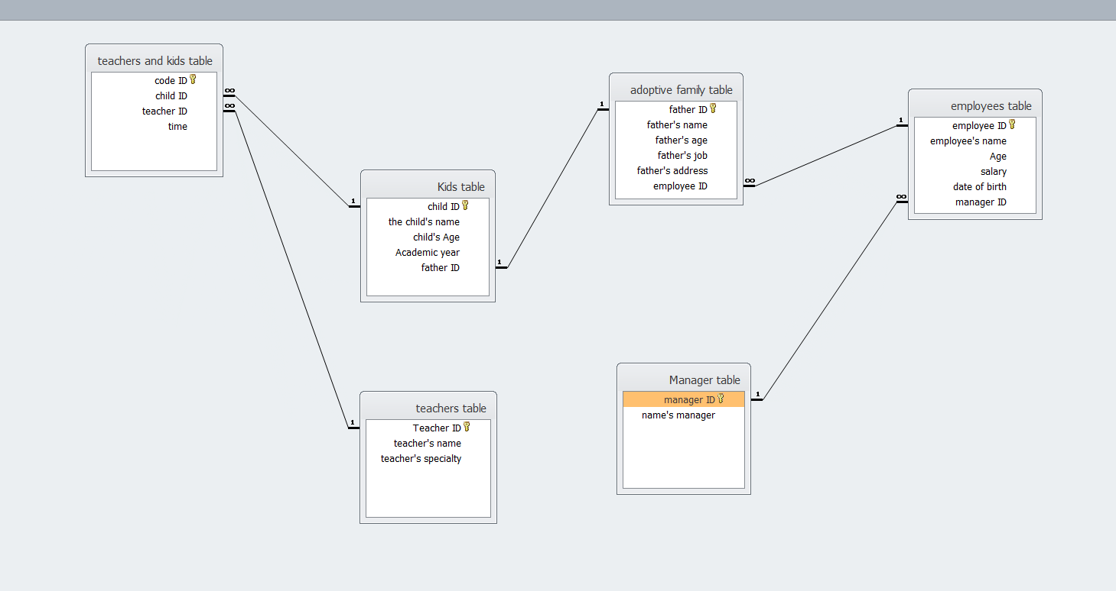
Relationships between members

Slide 7
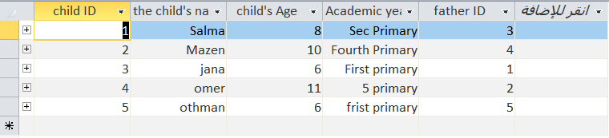
kids table

Slide 8
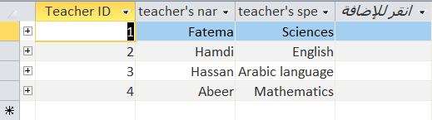
teachers table

Slide 9
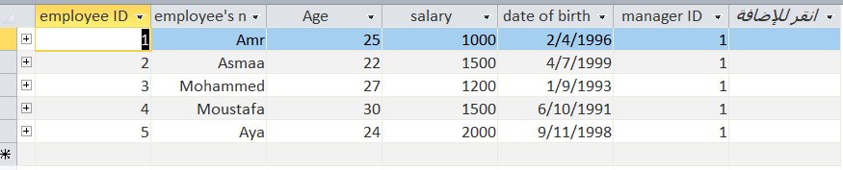
Employees table

Slide 10
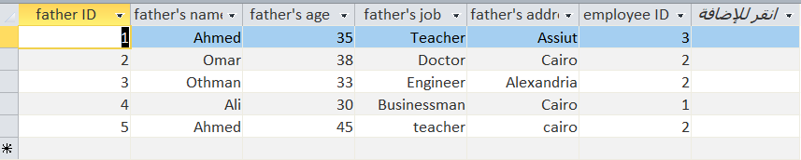
adoptive family table

Slide 11
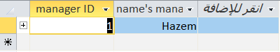
Manager table

Slide 12

QUERIES

Slide 13
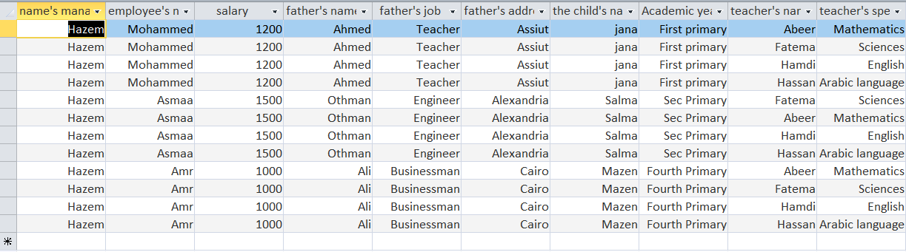
Query design

Slide 14
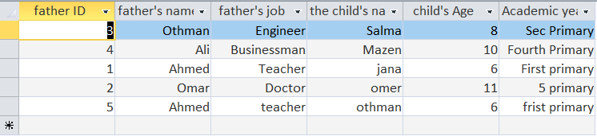
Select query 1

Slide 15
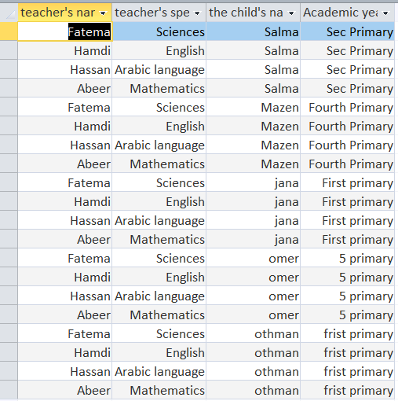
Select query 2

Slide 16
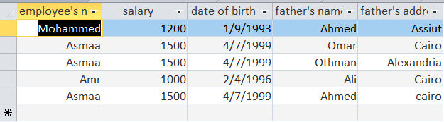
Select query 3

Slide 17
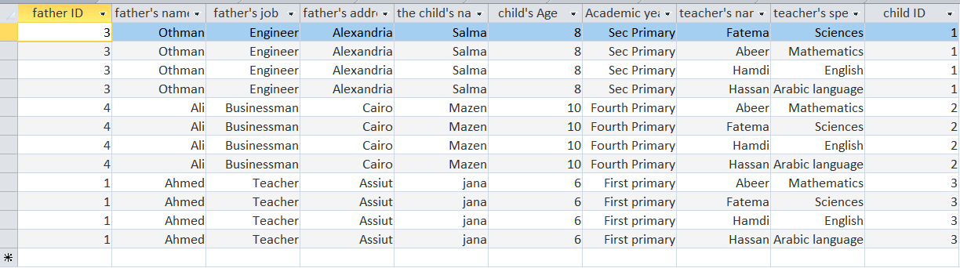
Select query 3

Slide 18
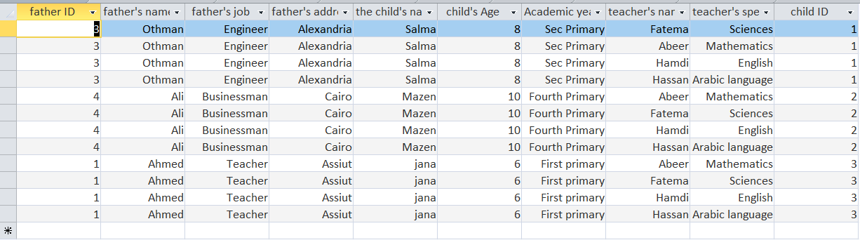
Select query 4

Slide 19
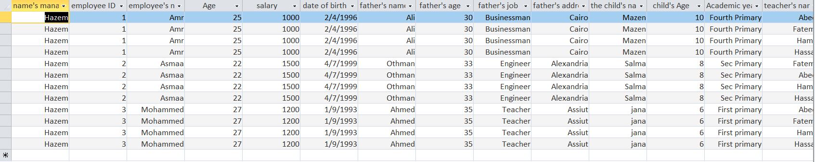
Select query 5

Slide 20

FORMS

Slide 21
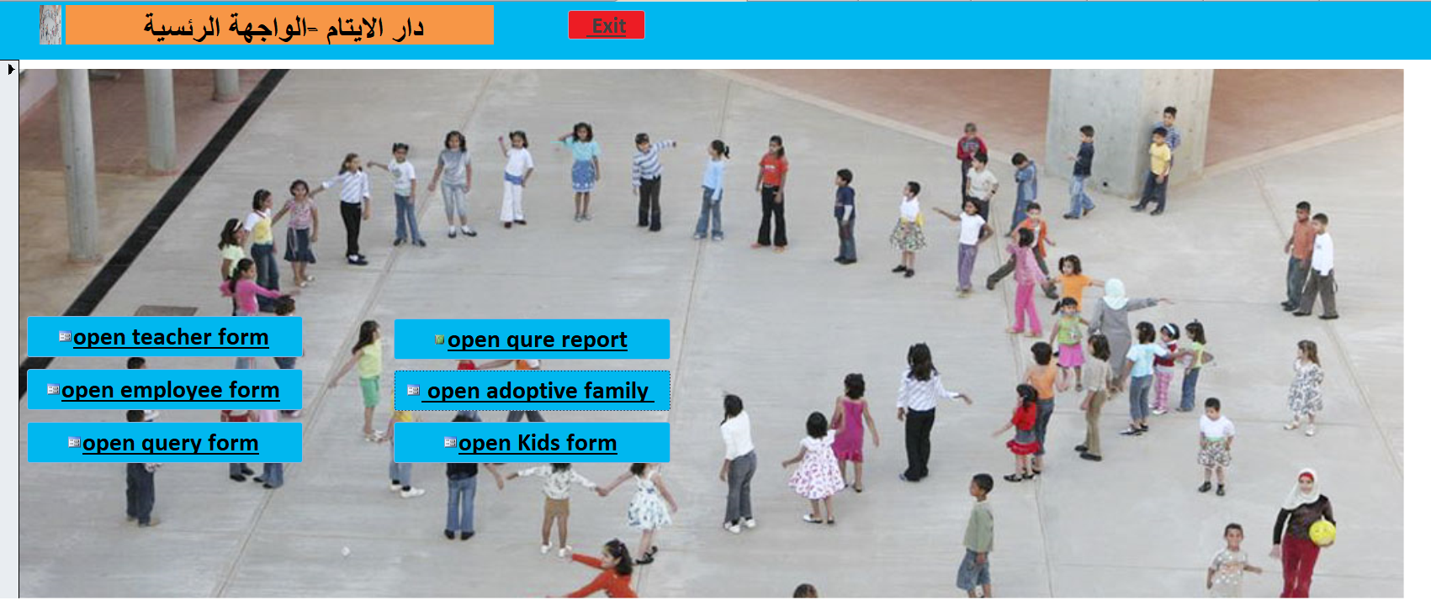
The main facade

Slide 22
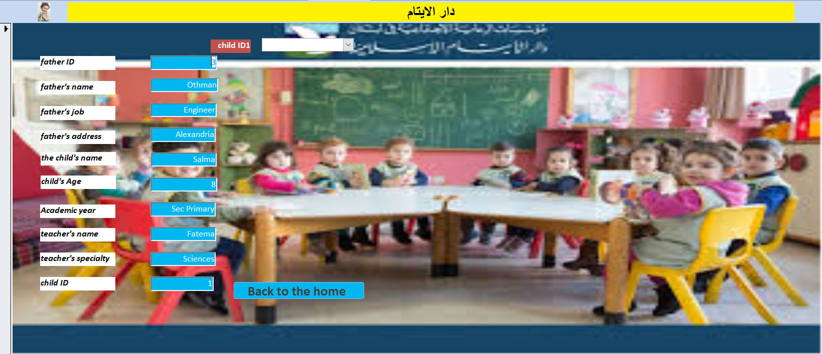
Query form

Slide 23
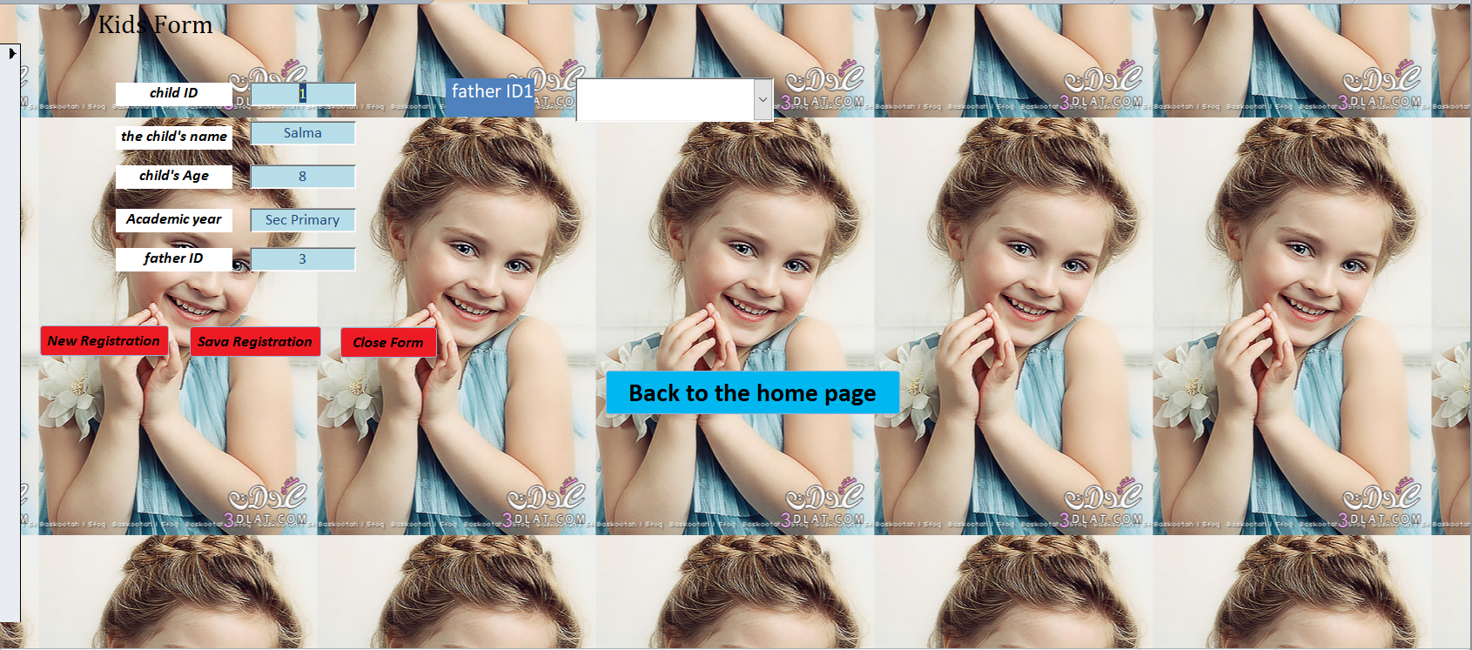
kids

Slide 24

teachers

Slide 25

Employees

Slide 26
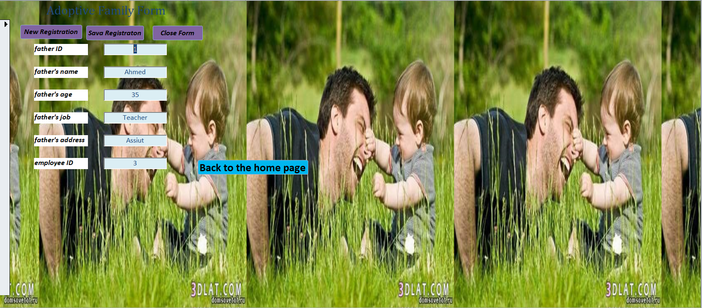
adoptive family

Slide 27

Manager

Slide 28
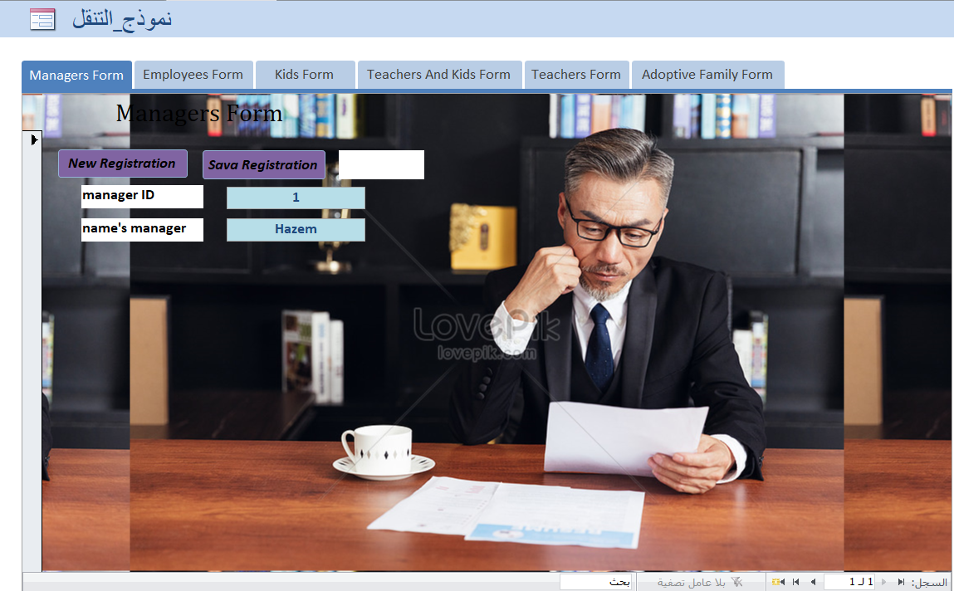
Navigation form

Slide 29

REPORTS

Slide 30
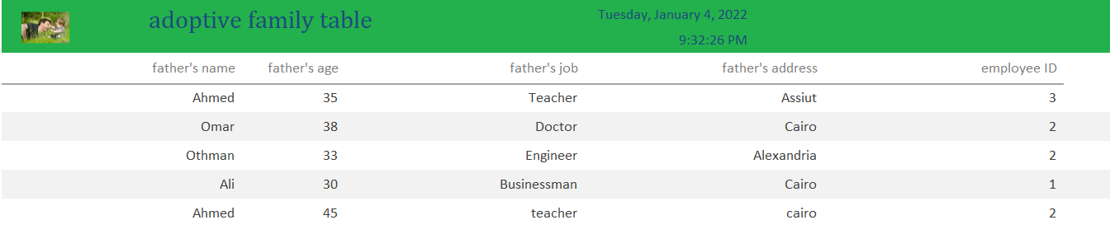
adoptive family

Slide 31
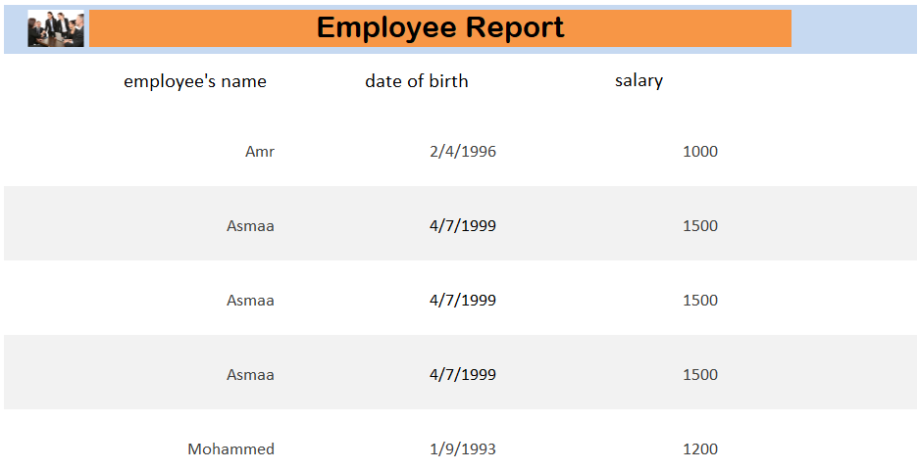
employees

Slide 32
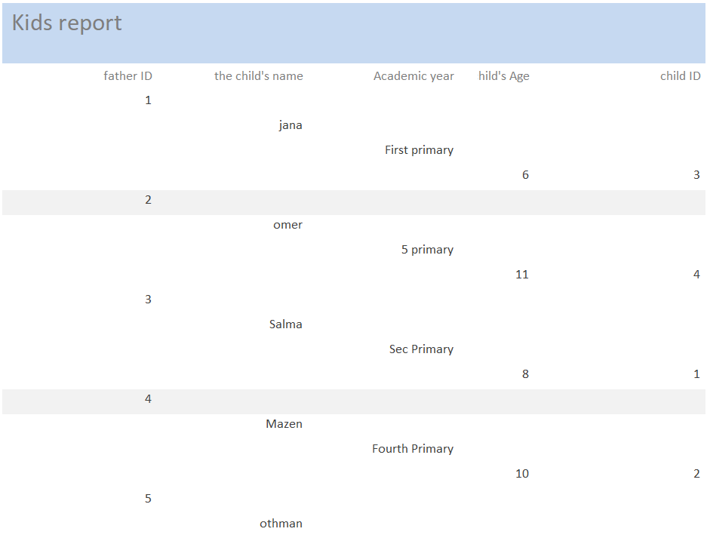
kids

Slide 33
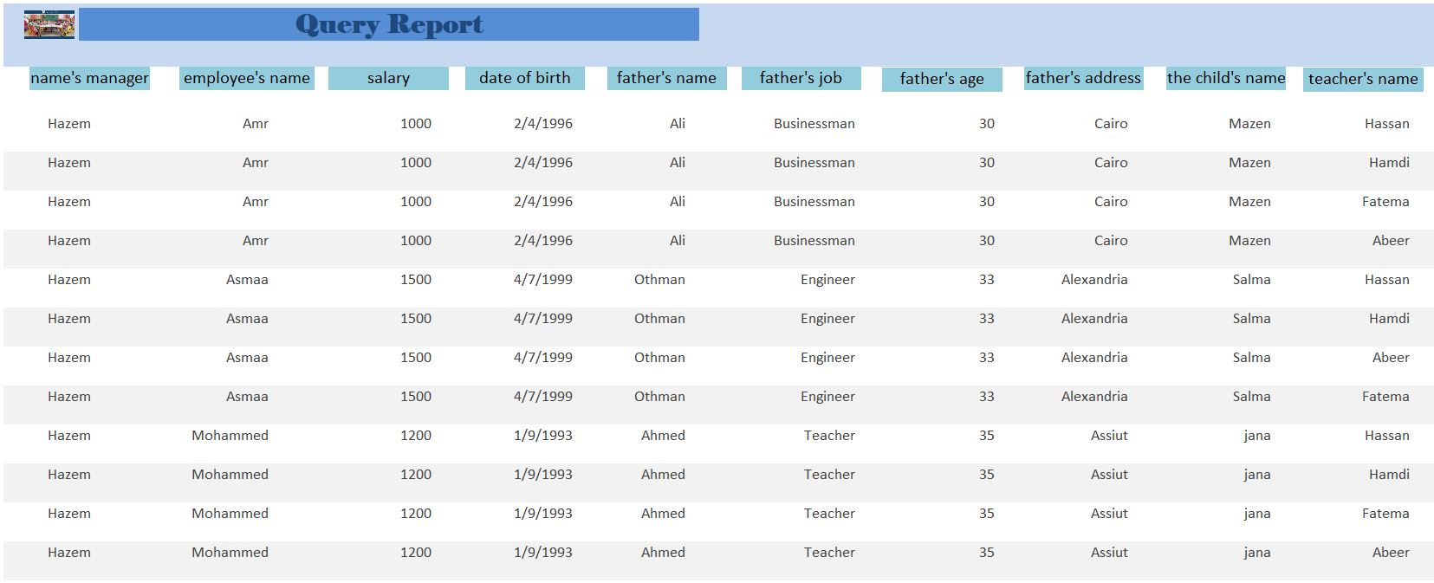
Query report

